Slide 1


Decision Tree Classification Algorithm
Faculty: Ms. Akanksha Vats
प्रगत संगणन विकास केन्द्र
Centre for Development of Advanced Computing
अनुसंधान भवन, सी-56/1, संस्थागत क्षेत्र, सैक्टर- 62, नोएडा- 201307 (उ.प्र.) भारत
Anusandhan Bhawan, C-56/1, Institutional Area, Sector- 62, Noida- 201307 (U.P.) India

Slide 2
Notice Regarding the Use of Images
This document contains images obtained by routine Google Images searches. Some of these images may perhaps be under copyright. They are included here for educational and noncommercial purposes and are considered to be covered by the doctrine of Fair Use. In any event they are easily available from Google Images.

Slide 3
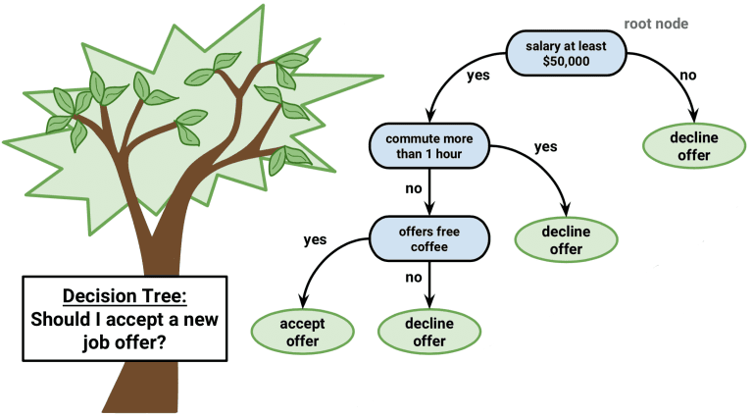
Decision Tree

Slide 4
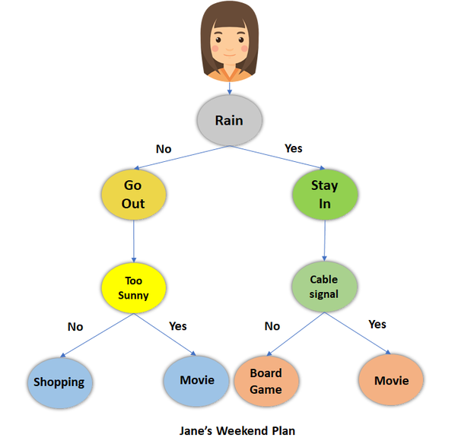
What is Decision Tress?
Decision Tree is a tree shaped diagram used to determine a course of action. Each branch of the tree represents a possible decision, occurrence or reaction.

Slide 5
What is decision Tree?
Decision Tree is a Supervised learning technique It is a tree-structured classifier, where internal nodes represent the features of a dataset, branches represent the decision rules and each leaf node represents the outcome.
In a Decision tree, there are two nodes, which are the Decision Node and Leaf Node. Decision nodes are used to make any decision and have multiple branches, whereas Leaf nodes are the output of those decisions and do not contain any further branches.
The decisions or the test are performed on the basis of features of the given dataset.
A decision tree simply asks a question, and based on the answer (Yes/No), it further split the tree into subtrees.

Slide 6


Slide 7
Problems that Decision Tree can Solve
Classification
A classification tree will determine a set of logical if-then conditions to classify problems. For example: Differentiating between 3 types of flowers based on certain feature
Regression
Regression tree is used when the target variable is numerical or continuous in nature. We fit a regression model to the target variable using each of the independent variable. Each split is made based on the sum of squared error.

Slide 8
Decision Tree: Important terms
Root Node: Root node is from where the decision tree starts. It represents the entire dataset, which further gets divided into two or more homogeneous sets.
Leaf Node: Leaf nodes are the final output node, and the tree cannot be segregated further after getting a leaf node.
Splitting: Splitting is the process of dividing the decision node/root node into sub-nodes according to the given conditions.

Slide 9

Attribute Selection Measures:
Entropy: Entropy is a metric to measure the impurity in a given attribute. It specifies randomness in data. Entropy can be calculated as:
S= Total number of samples
P(yes)= probability of yes
P(no)= probability of no
Information gain: Information gain is the measurement of changes in entropy after the segmentation of a dataset based on an attribute. According to the value of information gain, we split the node and build the decision tree.
Information Gain= Entropy(S) [(Weighted Avg) *Entropy(each feature)]

Slide 10
Pruning: Getting an Optimal Decision tree
Pruning is a process of deleting the unnecessary nodes from a tree in order to get the optimal decision tree.
A too-large tree increases the risk of overfitting, and a small tree may not capture all the important features of the dataset. Therefore, a technique that decreases the size of the learning tree without reducing accuracy is known as Pruning.

Slide 11
Advantages Of Decision tree
Simple to understand, Interpret and visualize.
Little effort required for data preparation.
Can handle both numerical and categorical data
Non linear parameter does not effect its performance

Slide 12
Disadvantages of Decision Tree
Overfitting : It occurs when the algorithm captures noise in data.
High Variance: the model can get unstable due to small variation in data.
Low biased tree: A highly complicated decision tree tends to have a low bias which makes it difficult for the model to work with new data.

Slide 13
Decision Tree In Real World
Churn Analysis
Sentiment Analysers
Investment Solutions
High Customer Satisfaction

Slide 14
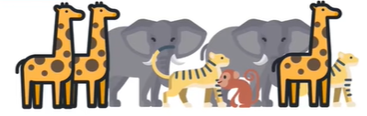
How Decision Tree Works?
Problem Statement: To classify different animals base don their features using decision tree.
Color | Height | Label
Grey | 10 | Elephant
Yellow | 10 | Giraffe
Brown | 3 | Monkey
Grey | 10 | Elephant
Yellow | 4 | Tiger

Slide 15
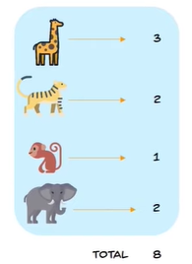


Formula for entropy:

Slide 16
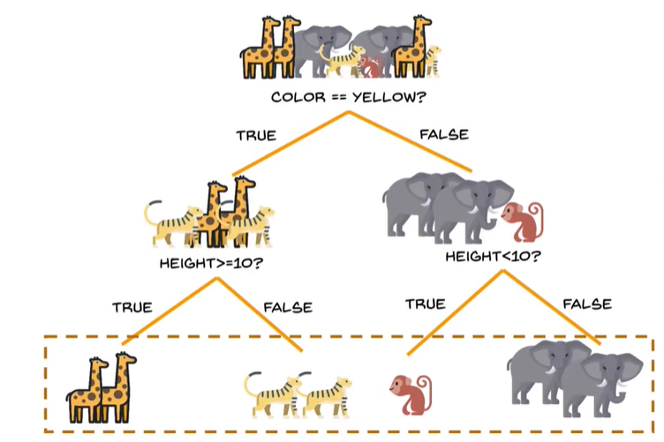
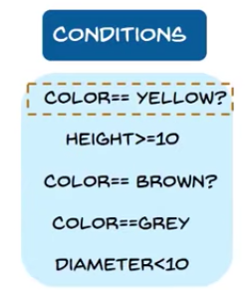

Slide 17
UseCase: Loan Repayment
This dataset explores publicly available data from LendingClub.com. Lending Club connects people who need money (borrowers) with people who have money (investors). The aim is to create a model to show profiles of borrowers with a high probability of paying back this loan.
Their are different attributes credit.policy, purpose, int.rate, installment, log.annual.inc, dti, fico, days.with.cr.line,revol.bal.

